Slide 1
My Research experiences in Traditional Knowledge
DR. RAJ K. MANCHANDA
M.D.(Hom.), M.B.A.(Health care)
Director General, Central Council for Research in Homoeopathy
Ministry of AYUSH, Govt. of India
Secretary for Research, LMHI

Slide 2
Indian Healthcare & Medical Paradox
INDIA
States with high MMR/IMR (Bimaru) (>60/1000 live births) and low MMR/IMR (<15/1000 births) (Kerala, Tamil Nadu)
Healthcare structure is
over-burdened by increasing population
Second most populous country
Highest number of both extremes, rich and poor, obese and malnourished
Highest number of TB/HIV/Leprosy infections
27% of conventional doctors for 85% of rural population
73% of conventional doctors for 15% of urban population
Twin epidemic of continuing/emerging infectious diseases as well as chronic degenerative diseases.

Slide 3
India’s disease burden distribution by 2020
An estimate*
*

Slide 4
TYPES OF KNOWLEDGE
TRADITION
RESEARCH
AUTHORITY
PERSONAL EXPERIENCE
TRIAL & ERROR

Slide 5
Tradition
  Tradition is what refers to longstanding, passed wisdom that occurs between or in communities.
  The concept of “Guru-Shisya”, “Father-Son” are the perfect examples of this type of knowledge.
  A majority of AYUSH practitioners are equipped with traditional use of Homoeopathy by virtue of knowledge imparted by the predecessor generations.
  It has been seen that knowledge passed on as traditional knowledge is poorly documented, for the reasons that it might be misused by others; and it must not be made public so easily.

Slide 6
Personal Experience
  The majority of AYUSH knowledge has been generated from personal experiences.
  This method is widely prevalent as it involves the accumulation of personal experience, free hand use of AYUSH, and recording of changes for future use.
  The domain is important as it involves the understanding of system intermingled with established experiences.

Slide 7
Authority
  AYUSH systems has been an evidence and authority based science since inception.
  In the early era, various authorities made it famous by their personal experiences, transcendental knowledge and practical tips.
  The authoritative knowledge strengthened the system and motivated physicians/public to widely use AYUSH in day to day practice
  Such source of knowledge has been run for years in the form of books and articles.

Slide 8
Trial and Error
  Trial and Error is what clinical experience is – True/False
  This method of knowledge generation involves usage of learned knowledge to arrive at a result after series of experiments at our own personal level.
  This may be one of the reasons why maximum new clinicians only use medicines that have been taught to them in their curriculum in initial years of practice, but gradually use more (and rare) remedies with the passage of time.

Slide 9
Research
  Research gives us new knowledge, and also verify the hypothesis.
  But how far the research knowledge is used in clinical homoeopathy, remains unclear.
  Knowledge generated from research may not always equal to application in clinical practices.
  This is the reason why we do not get clinical studies on the same theme on which research was undertaken and concluded.

Slide 10
BIBLIOGRAPHY
[Traditional Knowledge] is a cumulative body of knowledge, know-how, practices and presentations maintained and developed by the peoples over a long period of time. This encompasses spiritual relationships, historical and present relationships with the natural environment, and the use of natural resources. It is generally expressed in oral form, and passed on from generation to generation by storytelling and practical teaching.
With traditional knowledge “the knowing is in the doing.”
This is the essential character of aboriginal traditional knowledge

Slide 11
BIBLIOGRAPHY
Traditional medicine has a long history. It is the sum total of the knowledge, skill, and practices based on the theories, beliefs, and experiences indigenous to different cultures, whether explicable or not, used in the maintenance of health as well as in the prevention, diagnosis, improvement or treatment of physical and mental illness.

Slide 12
WHO Traditional Medicine Strategy 2014-2023

Slide 13
WHO Traditional Medicine Strategy 2014-2023

Slide 14
Strategic objectives /India Scenario
To build the knowledge base for active management of T&CM through appropriate national policies;
Government patronage
Many government funded colleges
Lakhs of practitioners
2. To strengthen quality assurance, safety, proper use and effectiveness of T&CM by regulating products, practices and practitioners;
Good laboratory practices
Good clinical practices
Good manufacturing practices
3. To promote universal health coverage by integrating T&CM services appropriately into health service delivery and self-health care.
Co location at PHC
Awareness activities to impact AYUSH use in public

Slide 15
WHO Traditional Medicine Strategy 2014-2023
Five essential ingredients for the conduct of quality TK research are discussed in these guidelines:
Solid Foundations, including putting together a good inter-disciplinary research team, matching research to objectives, using systematic research designs, and selecting appropriate samples;
Basics, such as choosing appropriate methods, understanding the nature of TK, and paying careful attention to language and Aboriginal (local) worldview;
Study Execution, including practical matters such as interview timing, space, equipment, matters to attend to during interviewing, and managing interview products in the field;
Spatial Knowledge Documentation, such as creating base maps, choosing appropriate software, creating and verifying data; and,
Post-Study Data Management, including practical considerations for long-term research product and data management.
Conduct of Traditional Knowledge Research— A Reference Guide
http://www.wmacns.ca/pdfs/416_ConductOfTraditionalKnowledge_fnl_WEB.pdf

Slide 16
LEVEL OF EVIDENCE
Level I meta-analyses and/or systematic reviews
Level IIa multiple controlled, randomized experiments
Level IIb some controlled, randomized experiments
Level IIIa studies with multiple cohorts
Level IIIb some cohort studies
Level IV opinion of experts

Slide 17
Grading of Recommendations
Grade | Recommendation
A (Evidence levels quality Ia, Ib) | Requires at least one randomized controlled trial as part of the body of literature of overall good and consistency addressing the specific recommendation.
B (Evidence levels IIa, IIb, III) | Requires availability of well-conducted clinical studies but no randomized clinical trials on the topic of recommendation.
C (Evidence level IV) | Requires evidence from expert committee reports or opinions and/or clinical experience of respected authorities. Indicates absence of directly applicable studies of good quality.

Slide 18
Western science and traditional knowledge
Western science and traditional knowledge: Despite their variations, different forms of knowledge can learn from each other
The WHO Traditional Medicine (TM) Strategy 2014–2023 was developed in response to the World Health Assembly resolution on traditional medicine. The goals of the strategy are to support Member States in:
harnessing the potential contribution of TM to health, wellness and people centred health care;
promoting the safe and effective use of TM by regulating, researching and integrating TM products, practitioners and practice into health systems, where appropriate.

Slide 19
How to improve the situation and to promote
the proper use and development of traditional medicine
¨ harmonize the use of certain accepted and important terms in traditional medicine;
¨ summarize key issues for developing methodologies for research and evaluation of traditional medicine;
¨ improve the quality and value of research in traditional medicine; and
¨ provide appropriate evaluation methods to facilitate the development of regulation and registration in traditional medicine.
General Guidelines for Methodologies on Research and Evaluation of Traditional Medicine

Slide 20
Clinical research
In addition to evaluating the safety and efficacy of traditional medicine through clinical trials, there may be a number of different objectives when evaluating traditional medicine through clinical research, as when using clinical research to evaluate conventional medicine. ]
Some of the objectives specific to the assessment of traditional medicine through clinical research are to:
¨ evaluate traditional medicine in its own theoretical framework ;
¨ evaluate traditional medicine in the theoretical framework of conventional medicine;
¨ compare the efficacy of different systems of traditional medicine and/or conventional medicine; and
¨ compare the efficacy of different traditional practices within a system of traditional medicine.
General Guidelines for Methodologies on Research and Evaluation of Traditional Medicine. WHO 2000

Slide 21
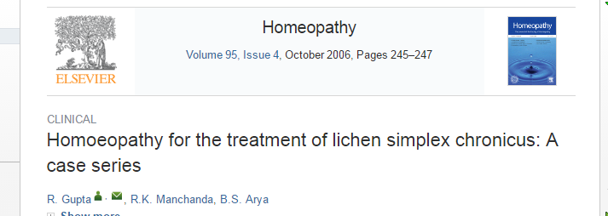
Abstract
Twenty-seven patients with chronic lichen simplex involving various parts of the body were treated. Hydrocotyle was prescribed to 21 patients in different potencies (6c, 30c, 200c, 1 M, 10 M), Thuja to three patients (1 M, 10 M), Graphites (6c), Kali bich (30c) and Sulphur (200c) to one patient each during 1 year study period. Only two patients showed complete improvement with Thuja and one with Graphites. In other cases, the response was limited to partial relief itching.

Slide 22
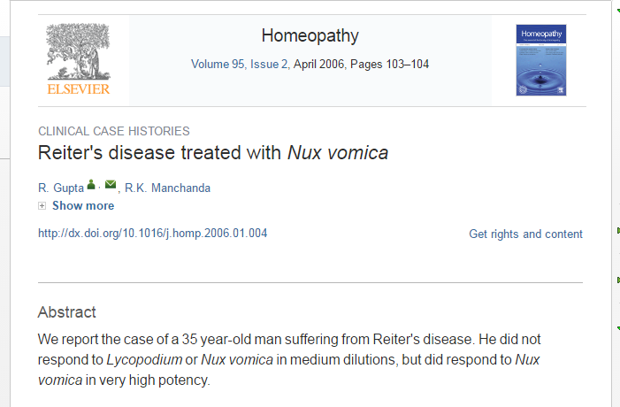

Slide 23
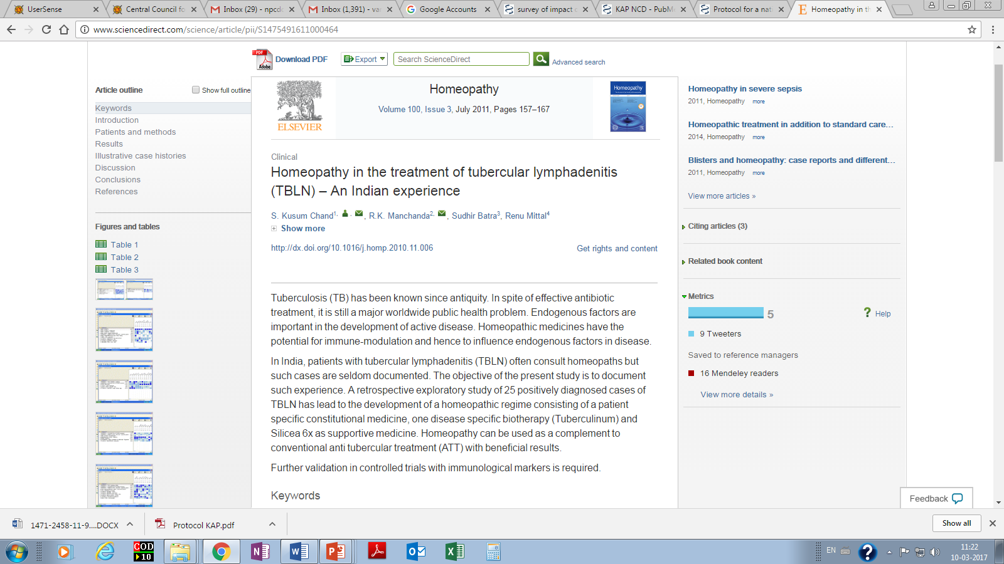

Slide 24
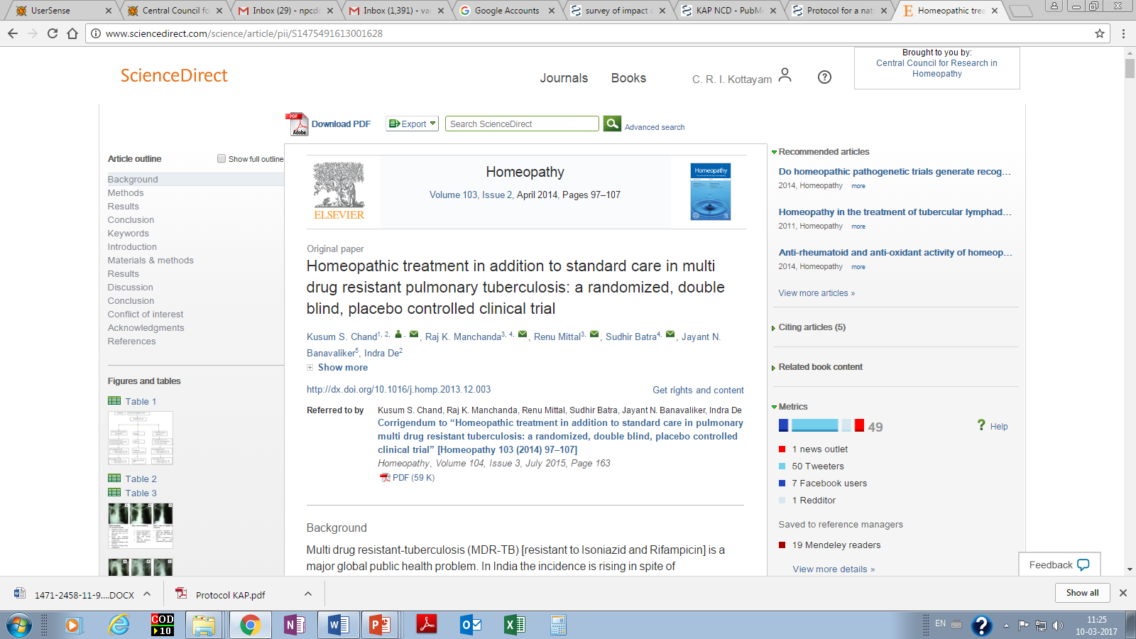
Add on homeopathy in addition to standard therapy appears to improve outcome in MDR-TB. Larger scale studies using a standardized homeopathic treatment regime should be conducted.

Slide 25
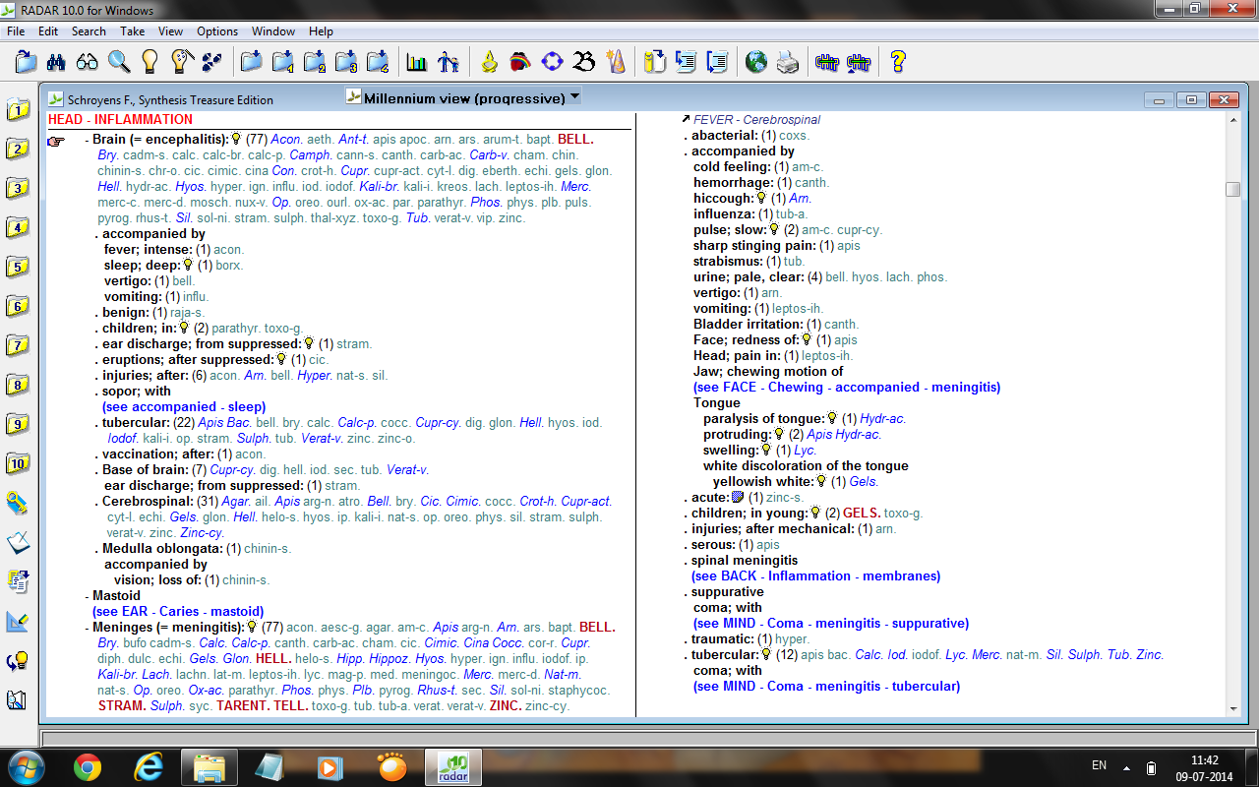
ANECDOTAL EVIDENCE ON ENCEPHALITIS
HOMOEOPATHY
Bell, Acon., Bry, Camph, Carb.v, Con., Cupr, Hell, Hyos, Kali br., Merc., Op, Op., Phos., Sil., Tub.

Slide 26
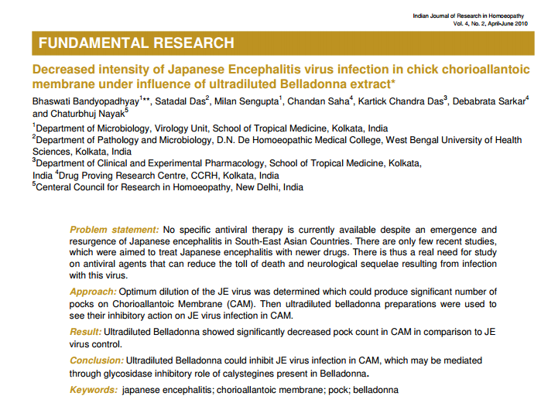
*The article was originally published in American Journal of Infectious Diseases 6(2): 24-28, 2010. Article is reprinted with the consent of the author and the publisher.

Slide 27
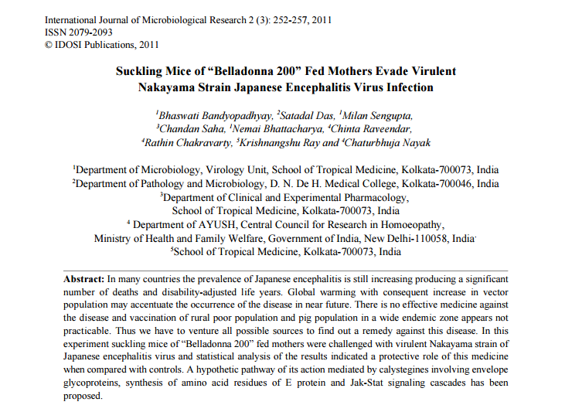

Slide 28
Clinical Study ongoing on AES by CCRH
Proposal to conduct randomized, double blind placebo controlled trial of homeopathic medicines-vs-placebo as add on to institutional management protocol for viral encephalitis (VE) in 2010
Protocol obtained ethical clearance and proceeded for registration in CTRI
However lack of clinical experience led to decision of conducting exploratory observational study in AES- 2012-13
An open label randomized placebo controlled pilot trial-2013, 2014, 2015

Slide 29
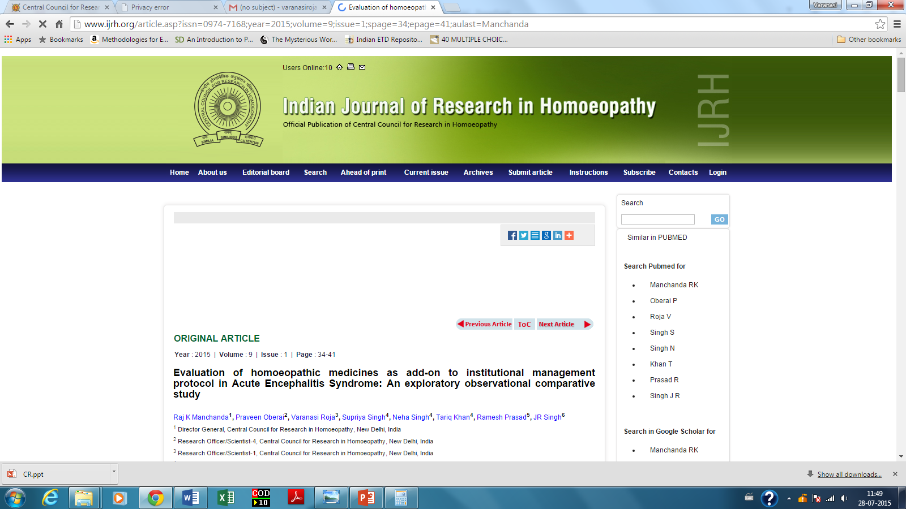
2015
Notes:
<number>

Slide 30
Outcome
The odds of having death in H+IMP is 0.17 which is less than 1 showing added benefits of Homoeopathy with absolute benefit increase of 33.4%

Slide 31

Flow of patients in the study-RCT
Excluded (n= 166)
Written informed consent not given (n=119)
No altered mental status (n=3)
Others (n=39)
Hepatic encephalopathy (n=1)
Pseudo seizure (n=1)
Seizer disorder (n=3 )
Screened (n= 814)
Enrolled (n= 648)
Randomised (n= 648)
H+IMP (n= 327)
IMP (n=321)
Excluded from analysis (n= 15)
Protocol violation (n=11)
Expired within 24 hrs (n=4)
Excluded from analysis (n= 21)
Protocol violation (n =20)
Expired within 24 hrs (n=1)
Analysed PP(n=306)
Analysed PP(n=306)

Slide 32
OUTCOME-RCT
Variable (GOS) | H+IMP (n=306) | IMP (n=306)
n (%)
Death | 39(12.5) | 87(28.4)
Neuro vegetative stage | 4(1.3) | 5(1.6)
Severe disability | 9(3) | 29(9.5)
Moderate disability | 8(2.6) | 32(10.4)
Good recovery | 246(80.7) | 153(49.8)

Slide 33
OUTCOME-RCT
Outcome | H + IMP (n=306) | IMP(n=306) | RR (95% CI) | ABI (95% CI) | OR (95% CI); p value
Effectiveness analysis |  | 57(46.11 to 72.6) | 26 (10.3 to 23.2) | 0.38(0.2 to 0.5); 0.0001¥
Bad outcome | 43(14.1) | 92(30.1) | The odds ratio for treatment response in the two groups was 0.38
Good outcome | 263(85.9) | 214(69.9)
BAD OUTCOME: Death, neuro vegetative state
GOOD OUTCOME: good recovery, moderate disability, severe disability

Slide 34
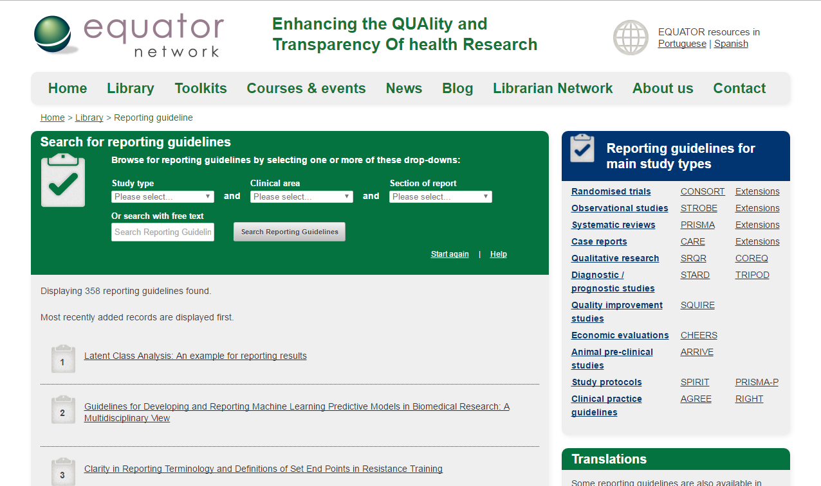

Slide 35
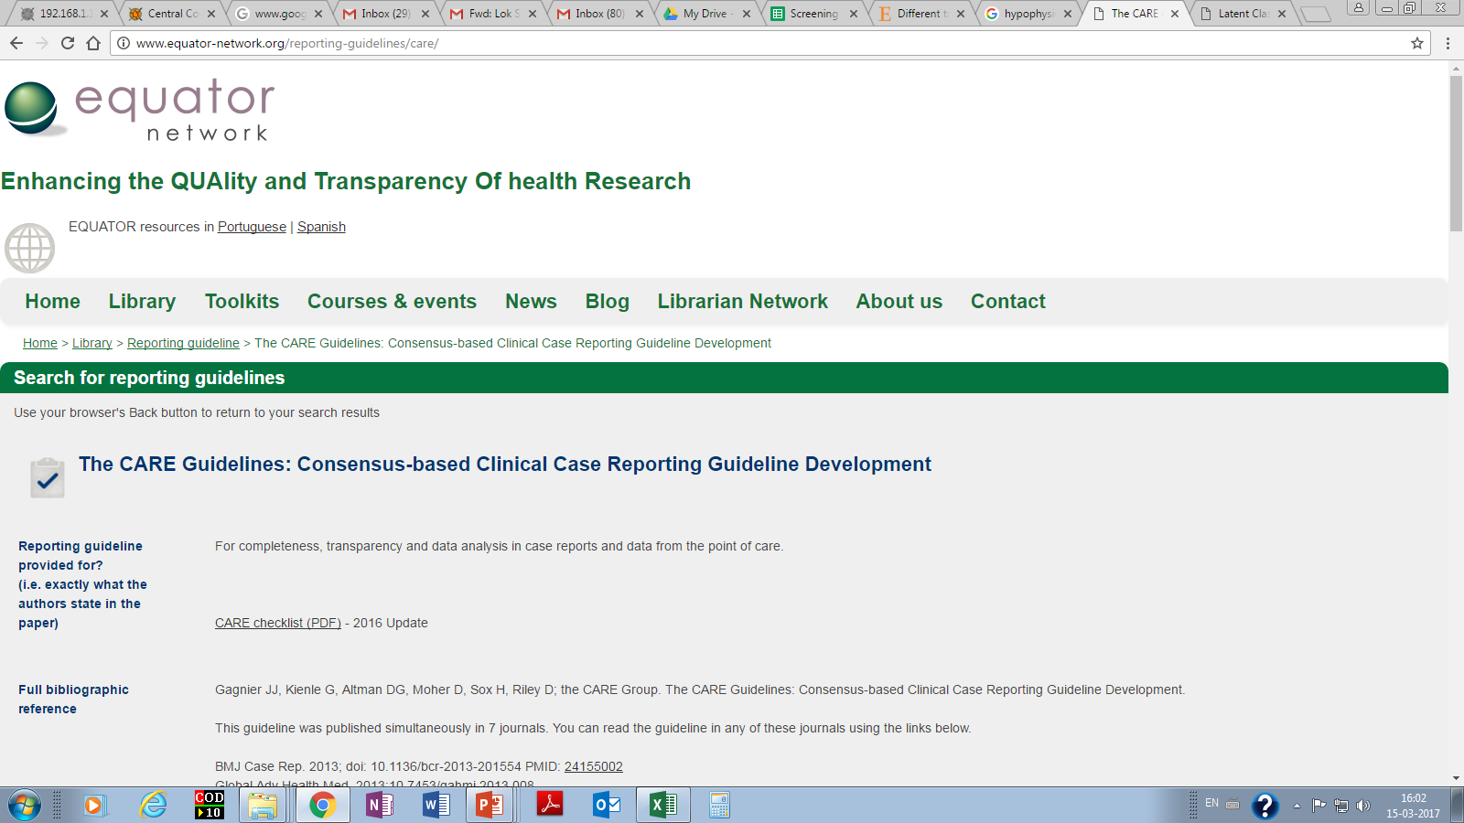
http://www.equator-network.org/reporting-guidelines/care/

Slide 36
REPORTING GUIDELINES

Slide 37

Thank you!

